Slide 1
SQL Installation Guide

Slide 2
Step 1 :
Open browser and type the link given below in address bar
https://www.mysql.com/downloads/

Slide 3
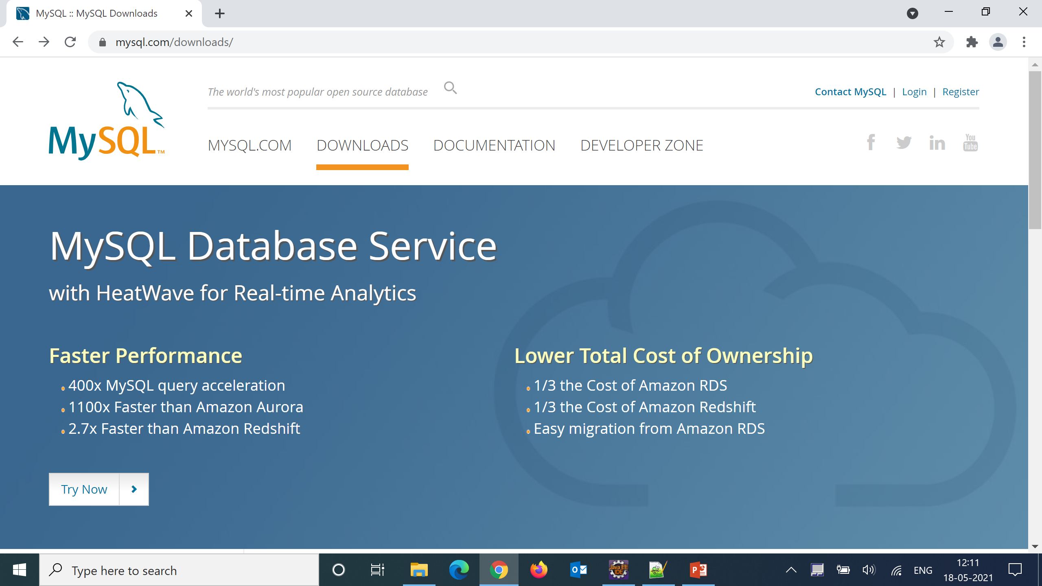
Step 2 :
Scroll down

Slide 4
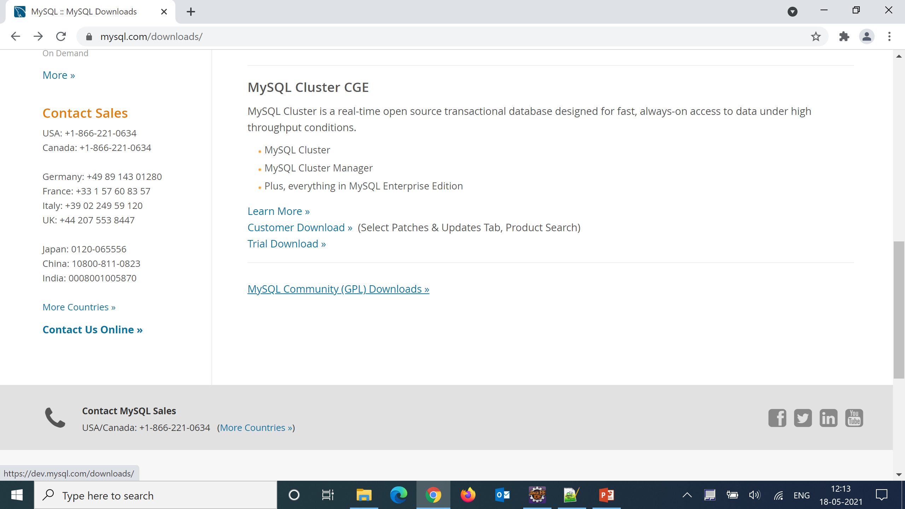
Step 3 :
Click on MySQL Community(GPL) downloads

Slide 5
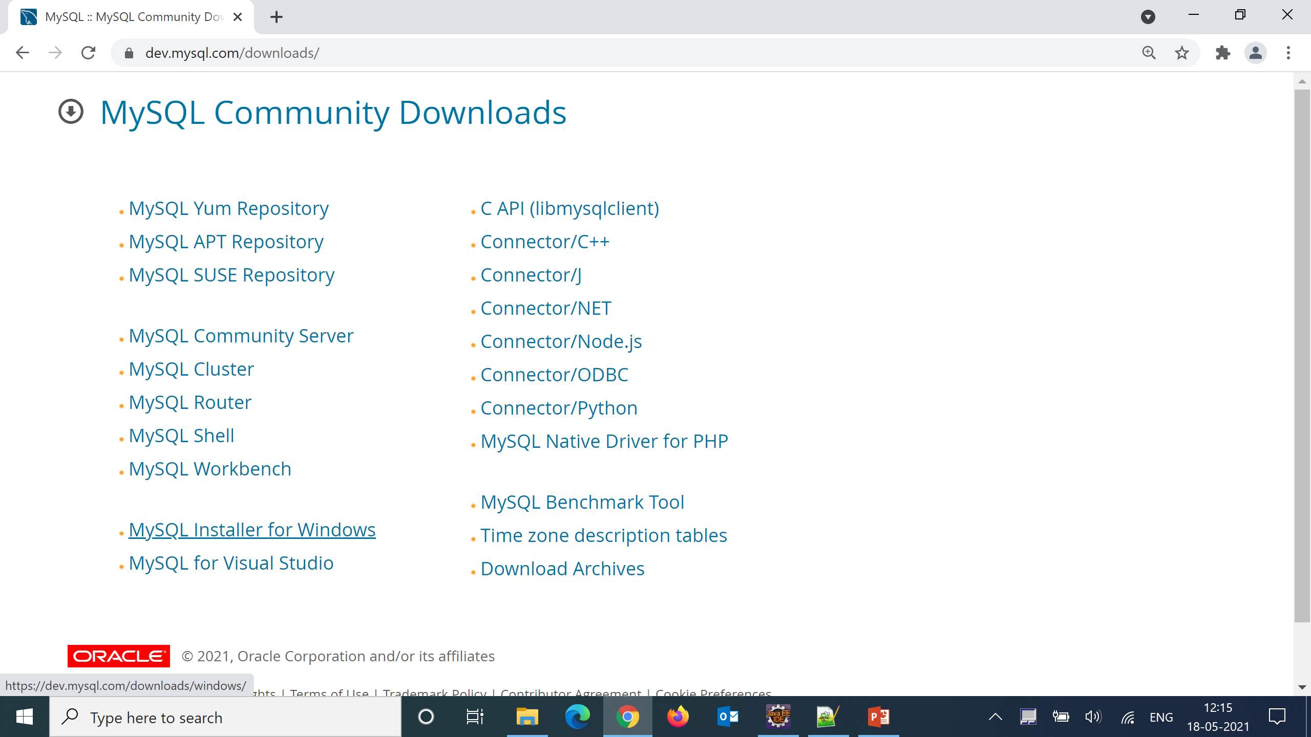
Step 4 :
On clicking MySQL community(GPL) downloads will be redirected here then
Click on MySQL installer for windows.

Slide 6
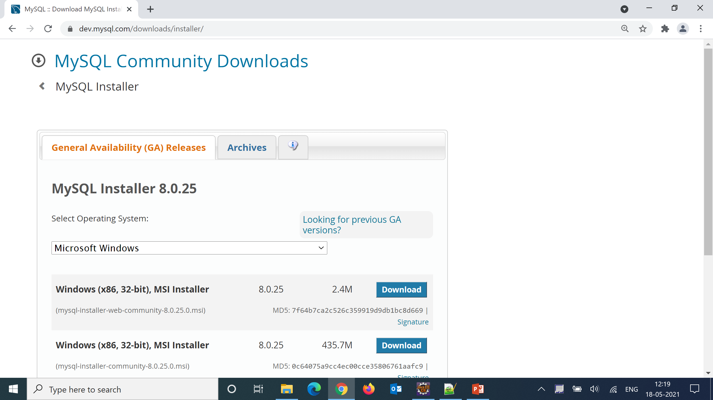
Step 5 :
In this page go to archives as we want to download previous stable version

Slide 7
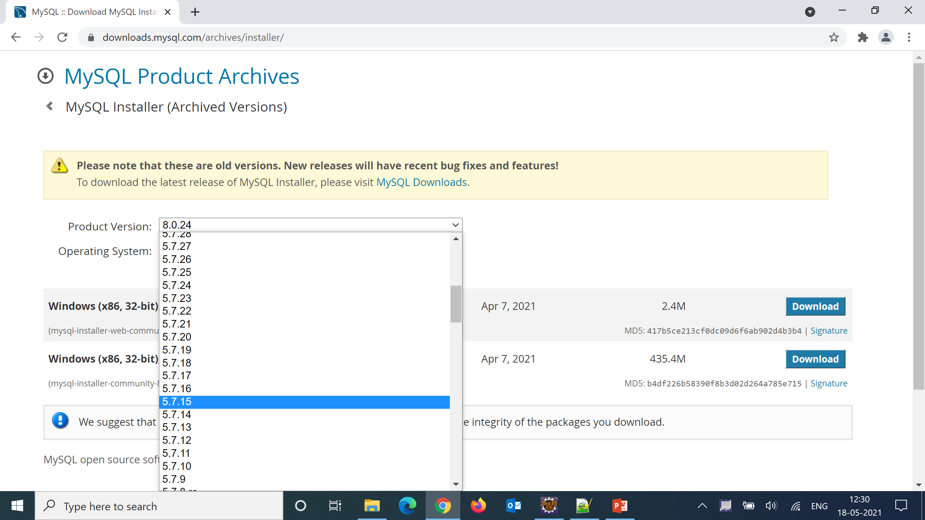
Step 6 :
Select 5.7.15 version from product version dropdown

Slide 8
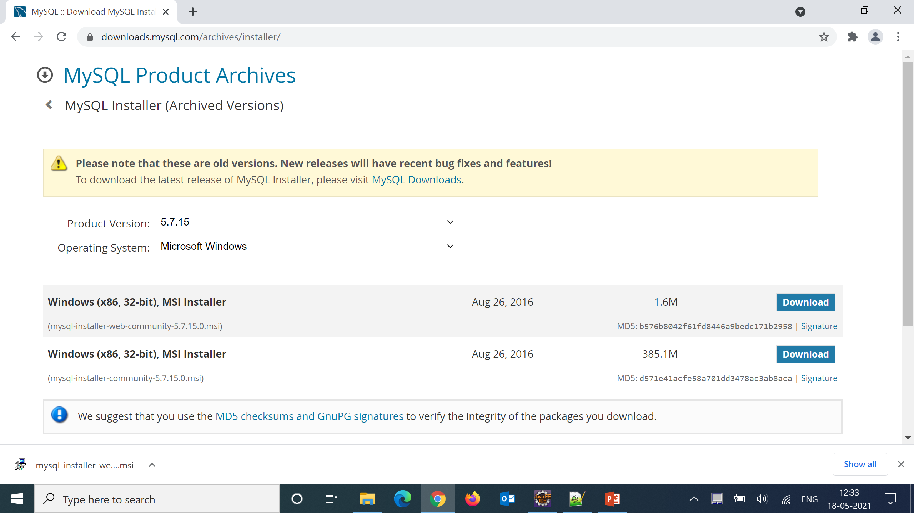
Step 6 :
After selecting version click on download button on msi installer with 1.6mb this inturn will download the installer

Slide 9
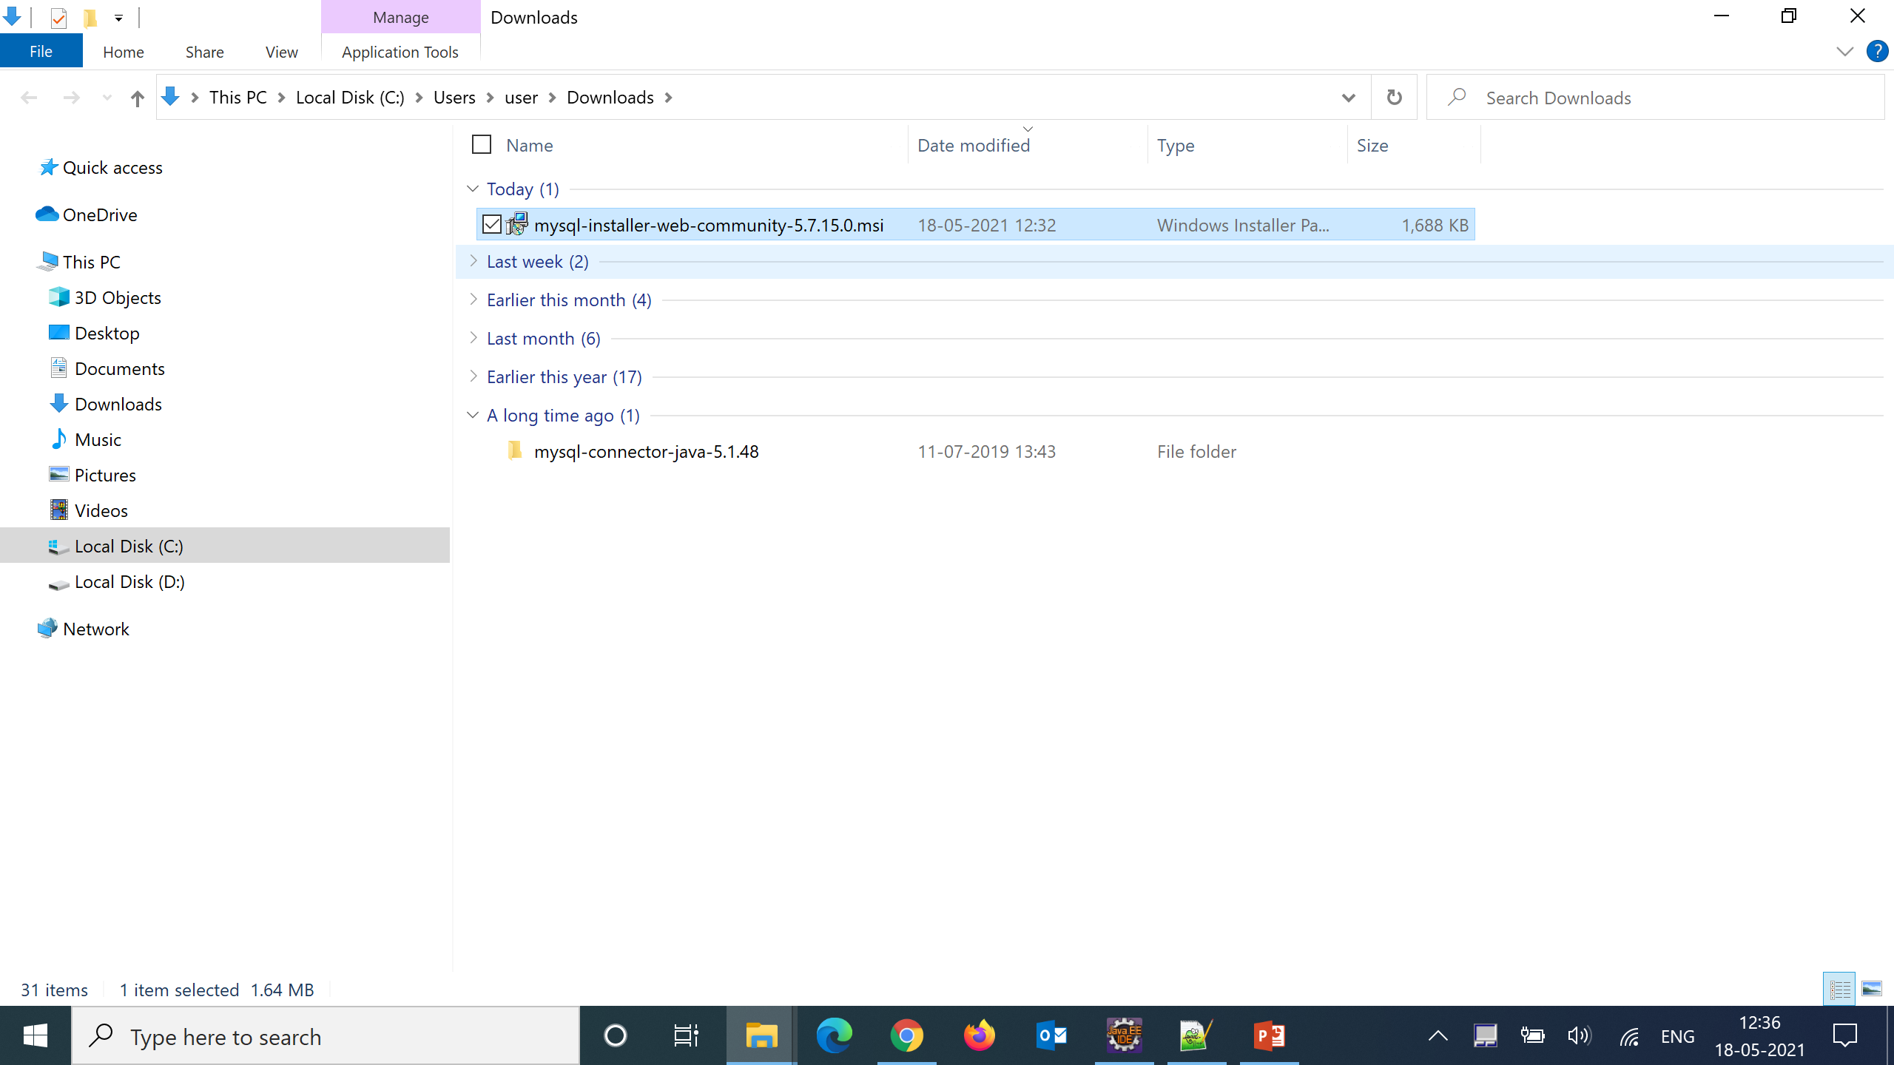
Step 7 :
Double click the downloaded installer in downloads folder

Slide 10
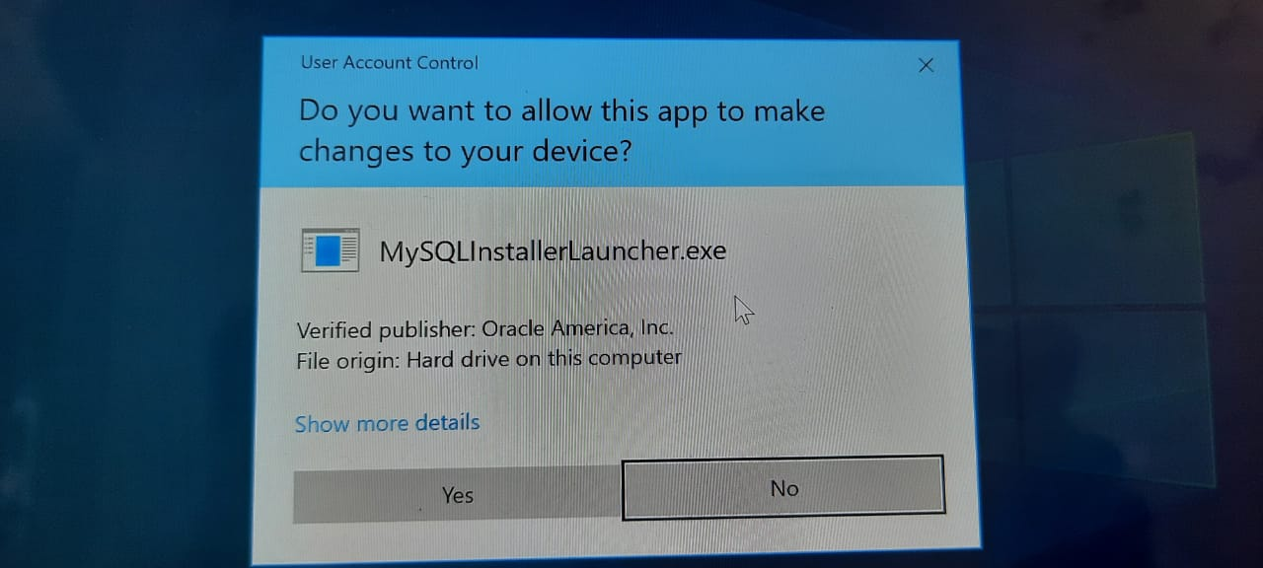
Step 8 :
By clicking yes continue installation

Slide 11
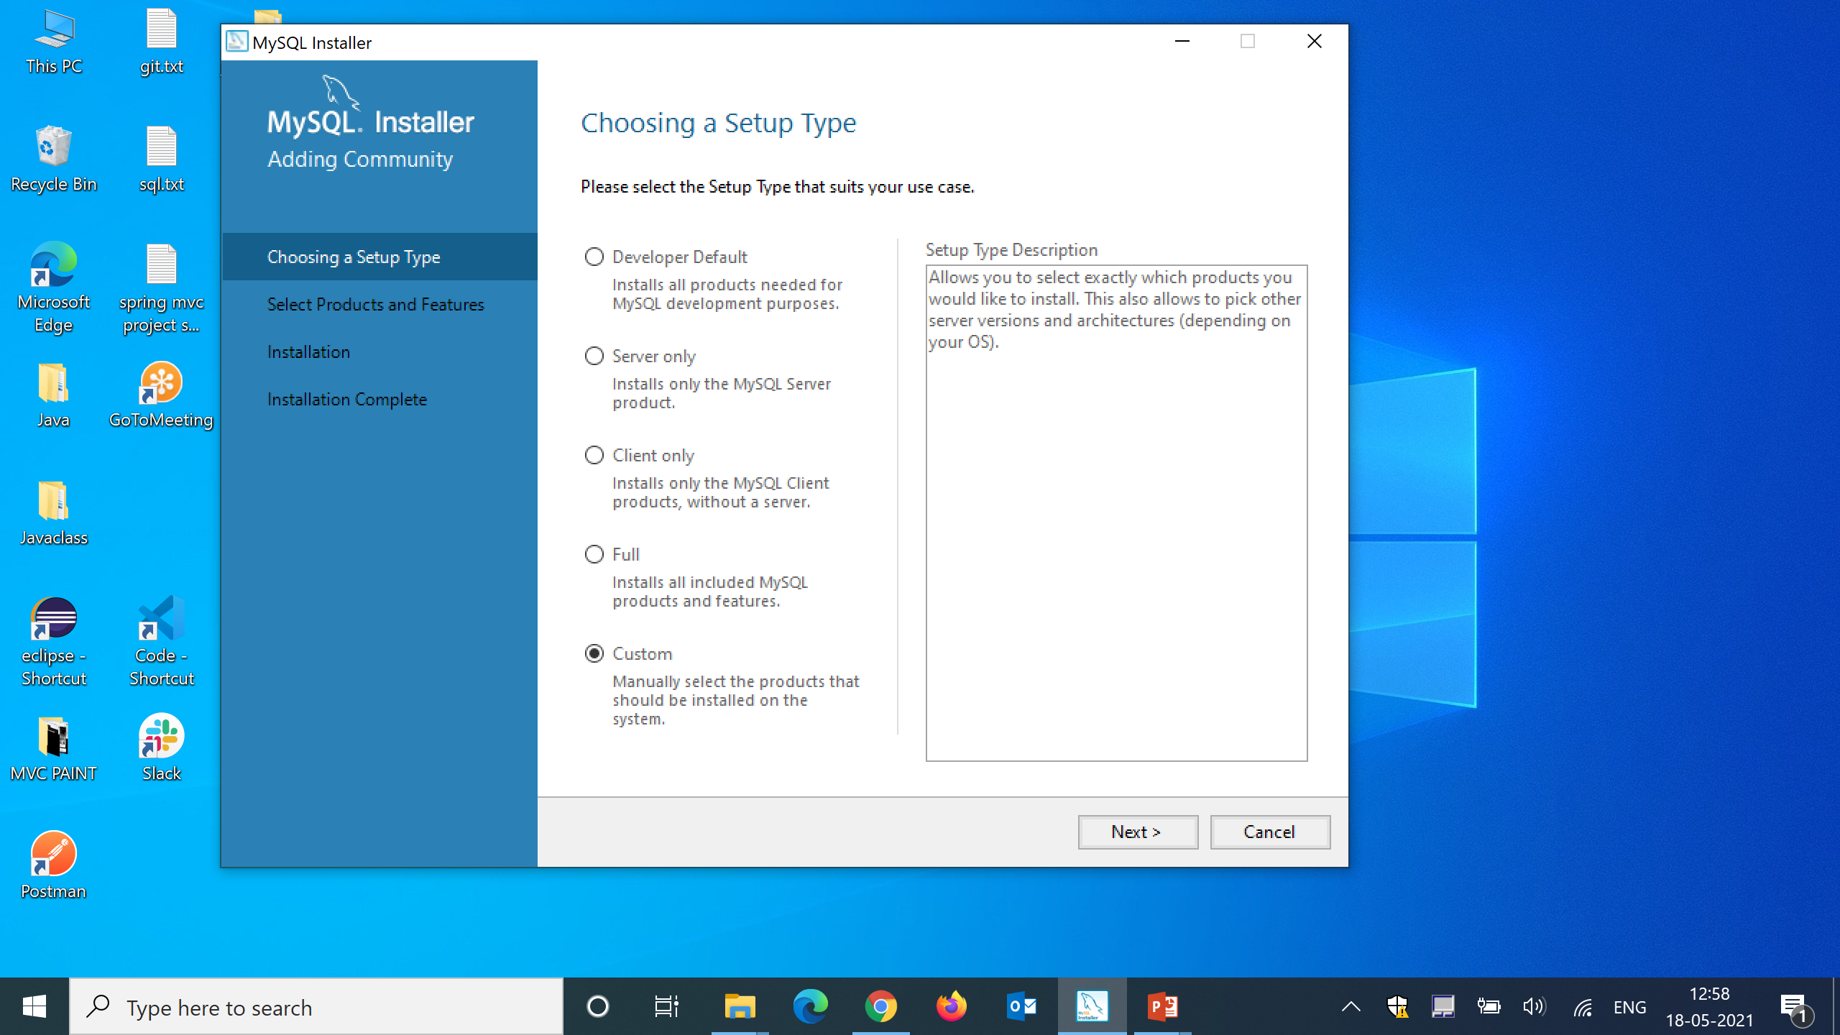
Step 9 :
Select custom and click on next

Slide 12
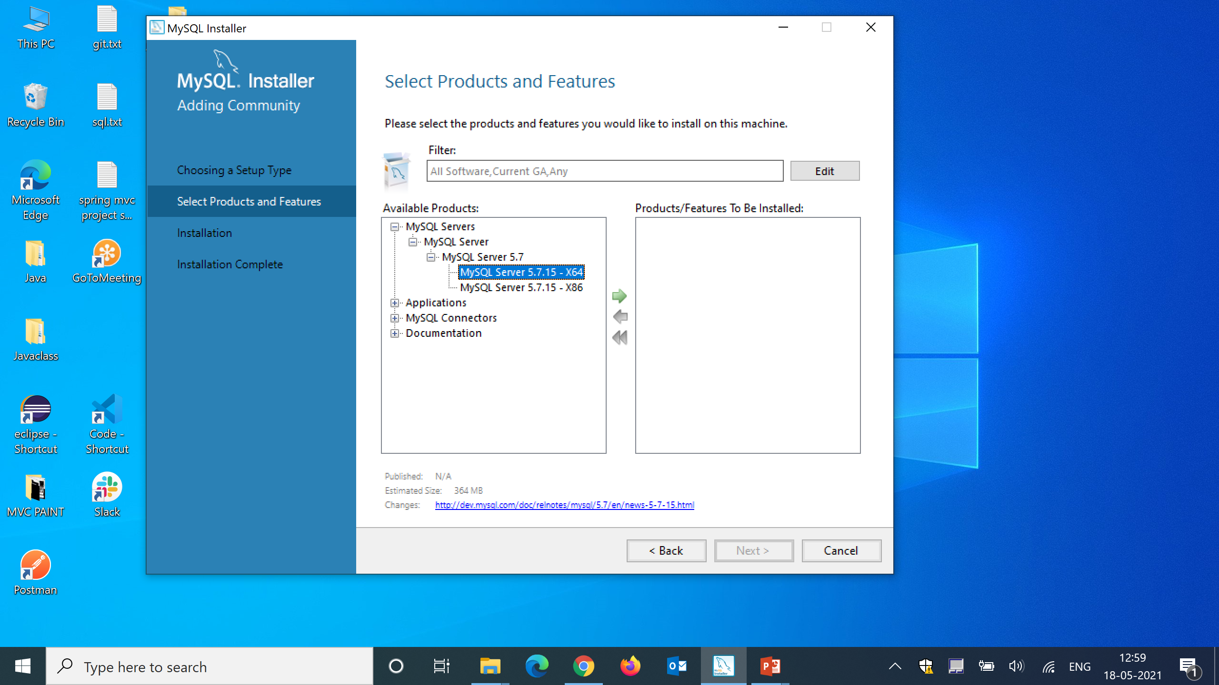
Step 10 :
Click on + icon beside to MySQL Servers and select mysql server and click on the arrow as shown in the picture below

Slide 13
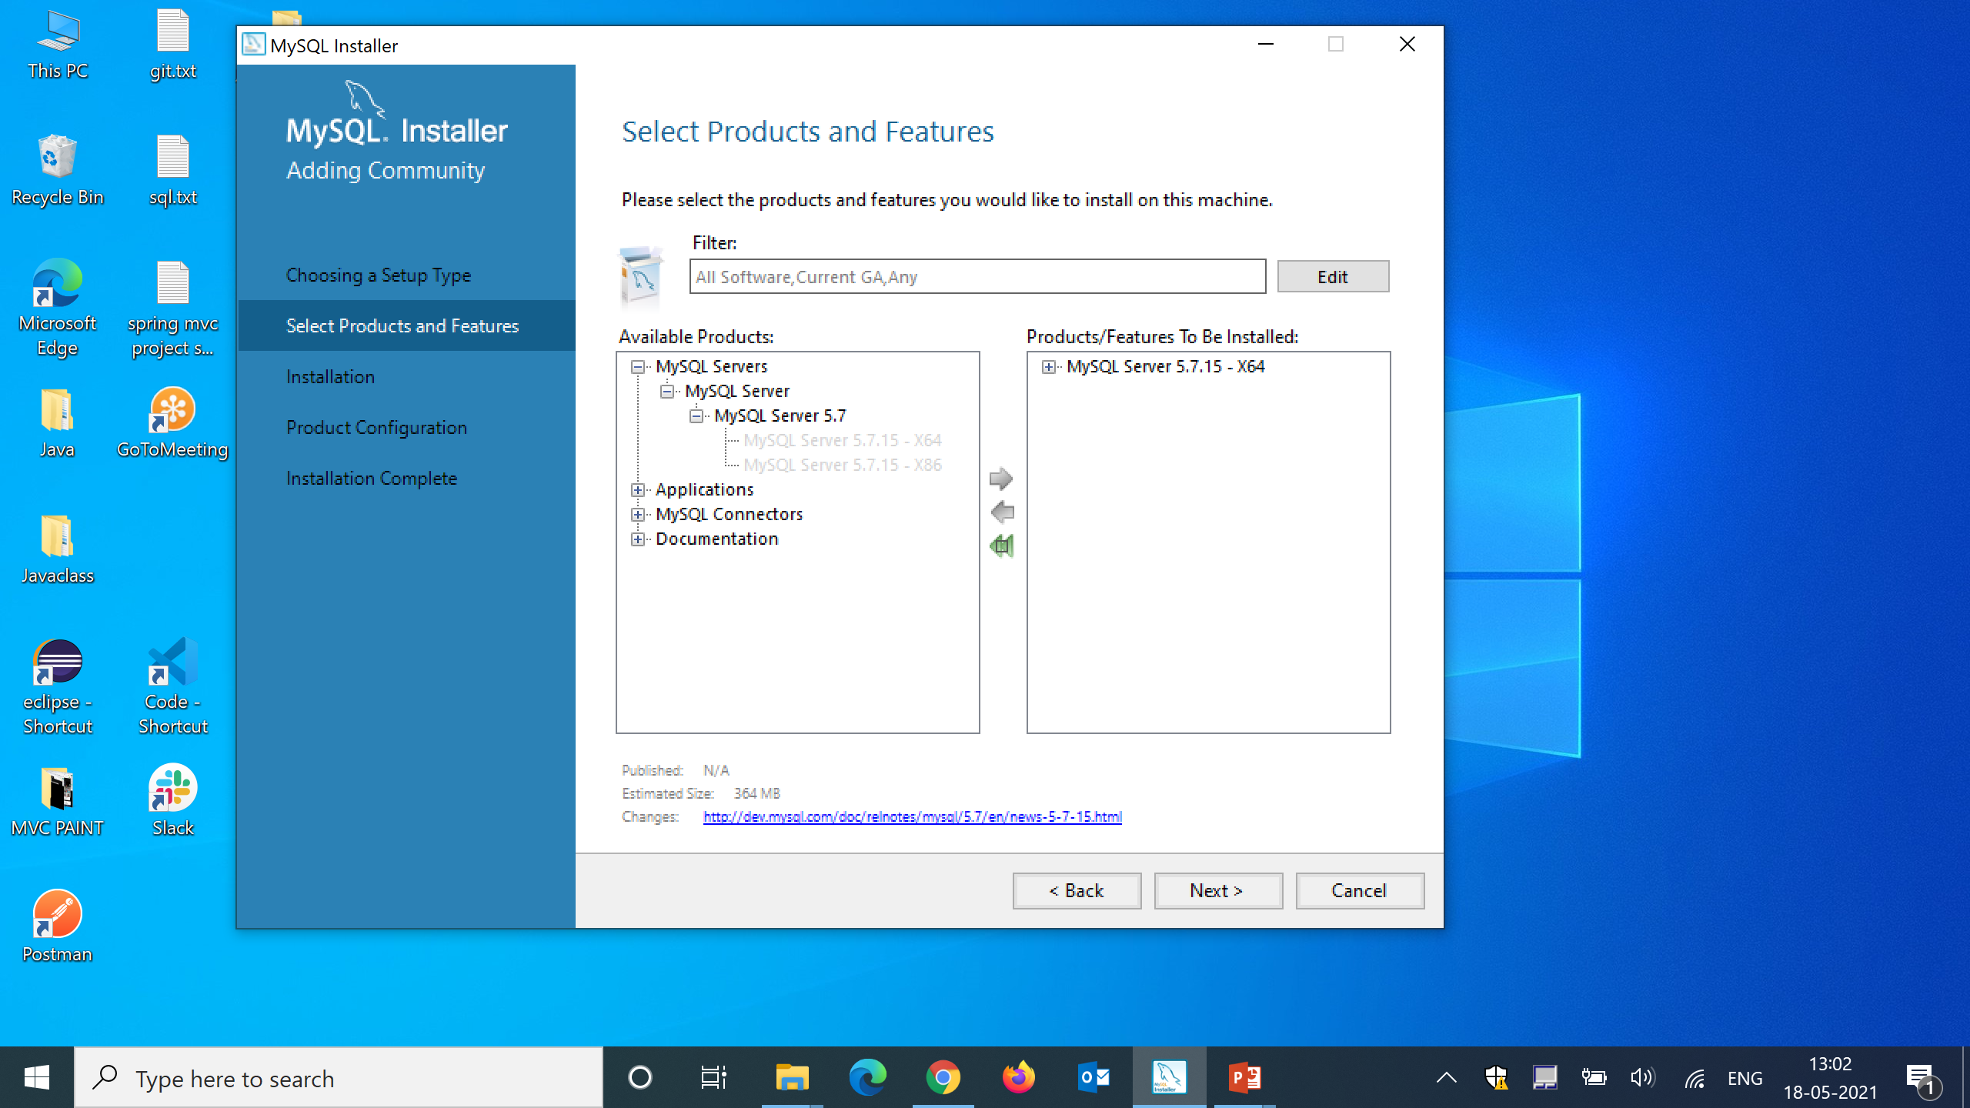
Step 11 :
On clicking arrow mysql server will be added to list of products to be installed as show below

Slide 14
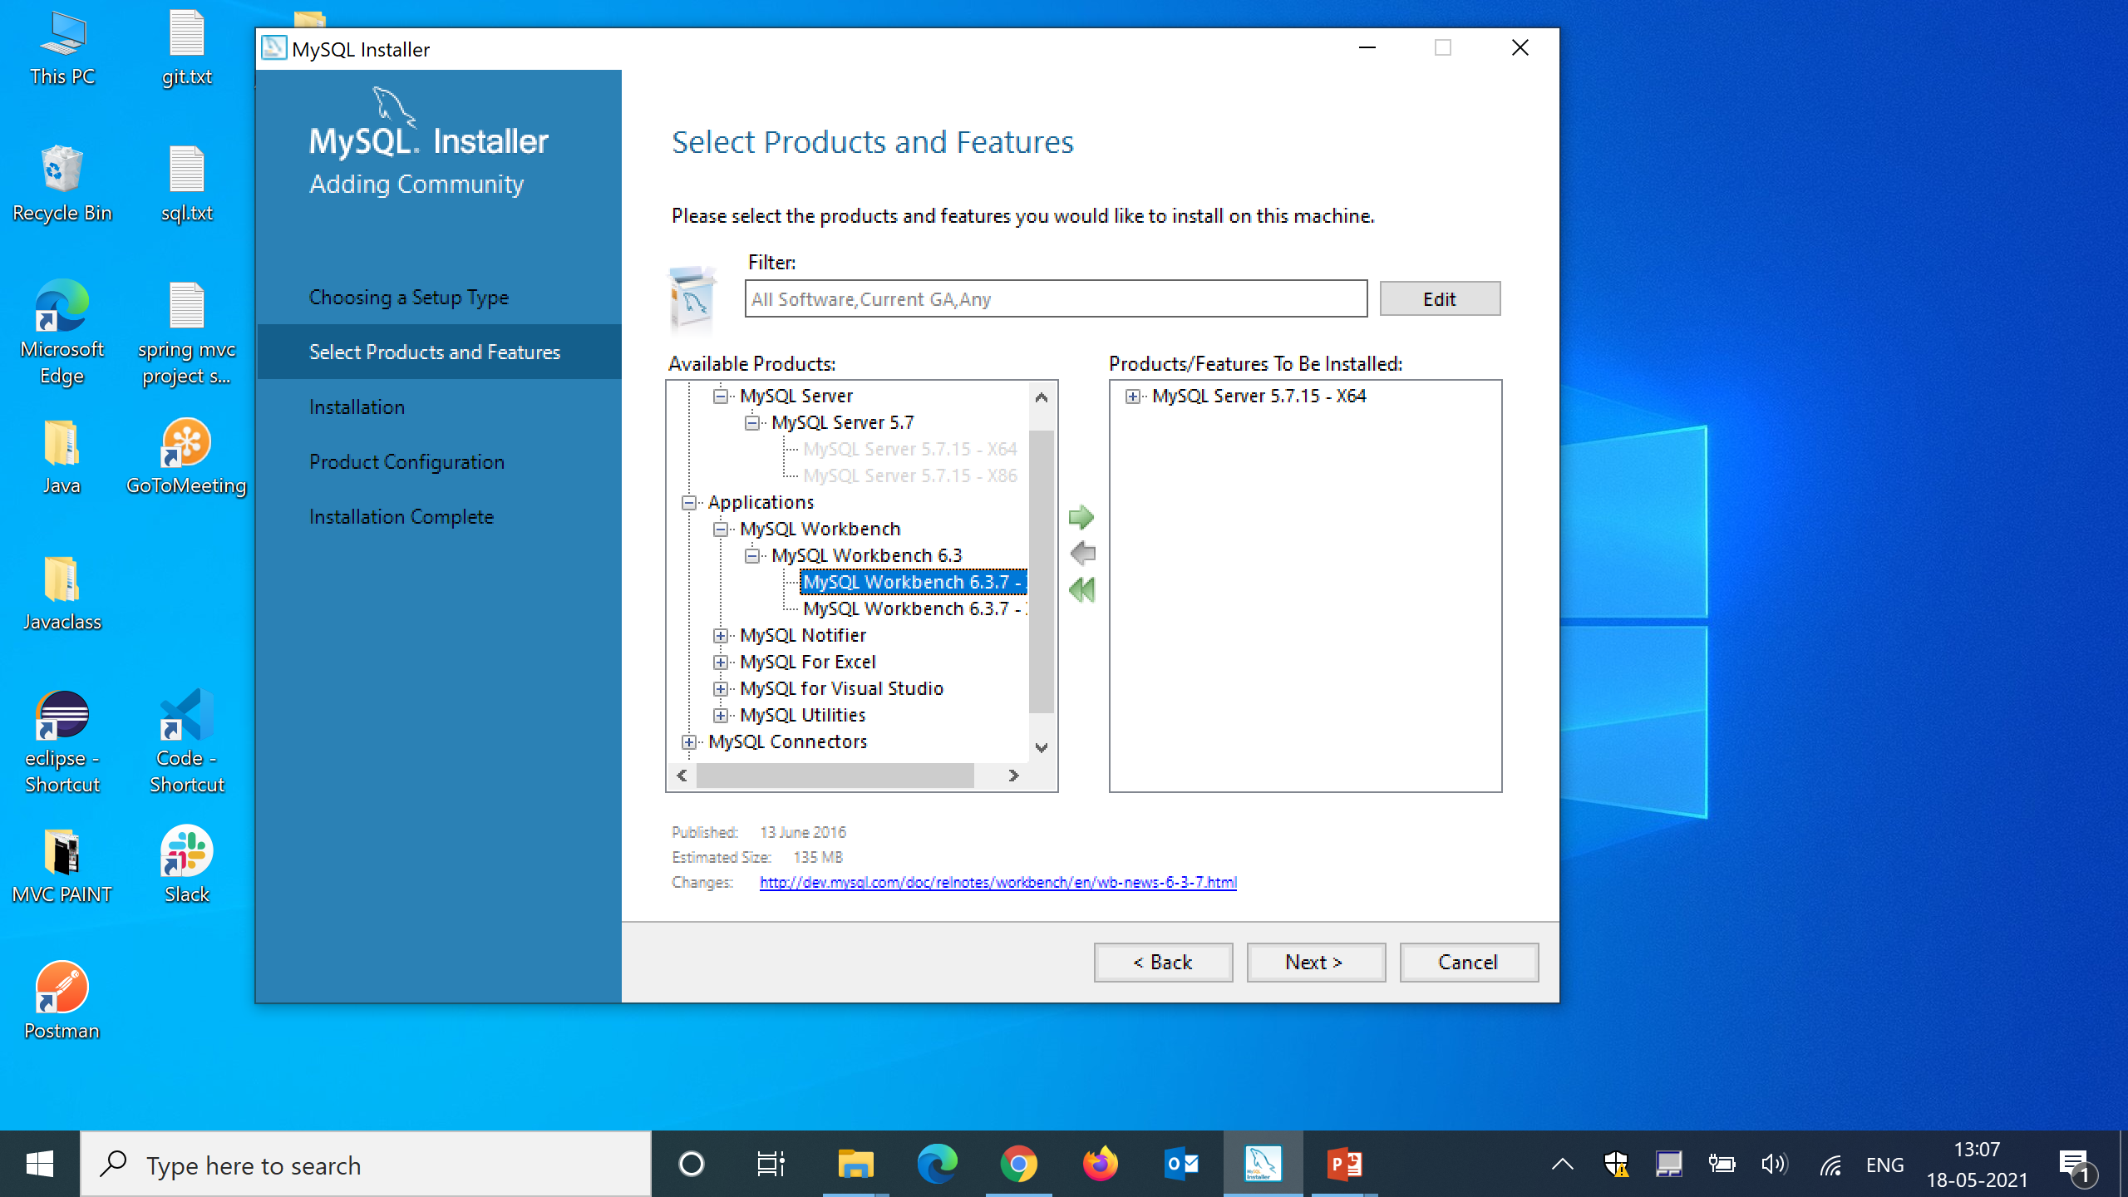
Step 12 :
As we selected server previously in a same way select MySQL workbench by clicking + icon beside to application as shown in the picture below and click on arrow .

Slide 15

Step 13 :
After adding workbench and server to products to be installed side as show below and then click on next.

Slide 16
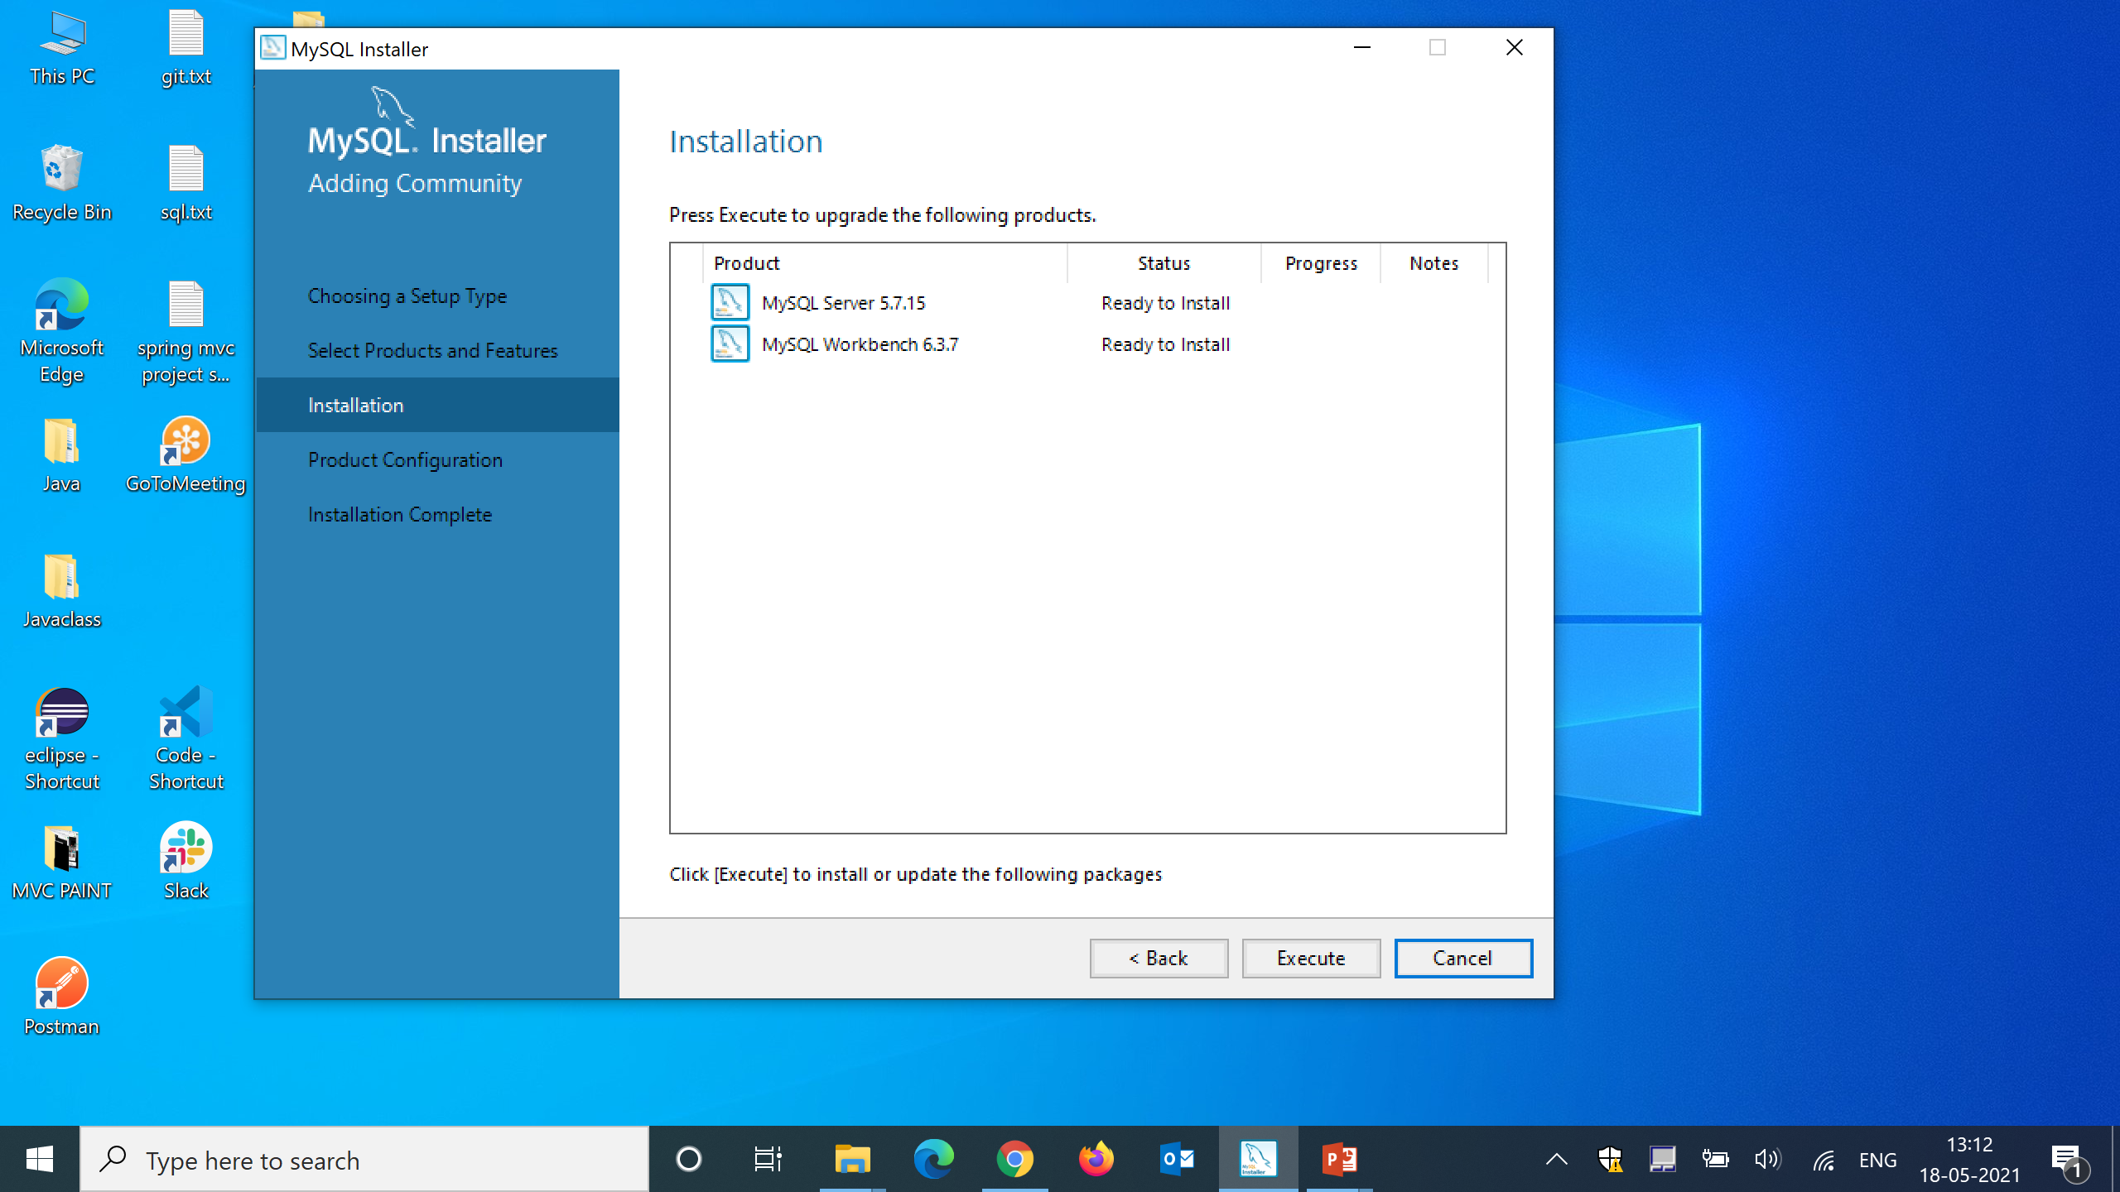
Step 14 :
After clicking next will get below dialogue box click on execute.

Slide 17

Step 15 :
After clicking execute installation will complete and then click on next.

Slide 18

Step 16 :
Again click on next

Slide 19
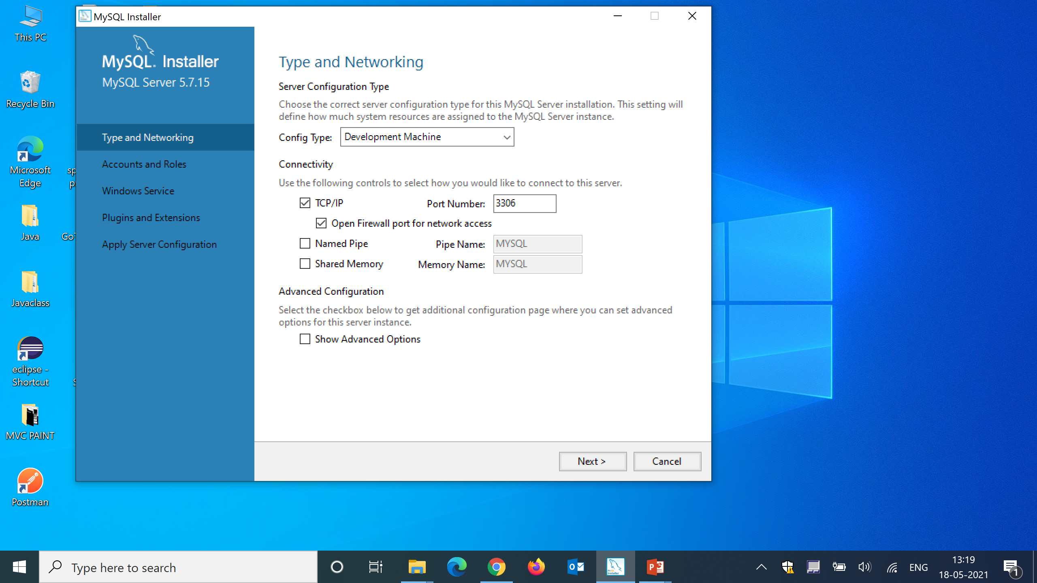
Step 17 :
Note the port number in which server is running and click on next

Slide 20
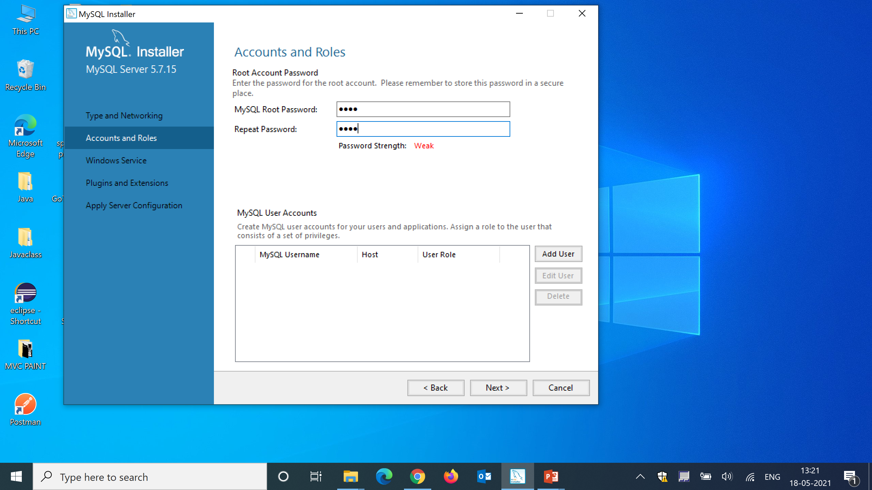
Step 18 :
Keep the password and remember as it is required every time you use to login in to MySQL and after typing password click on next.

Slide 21
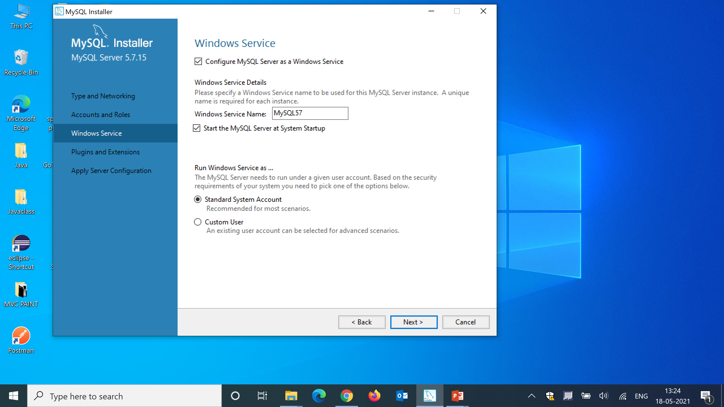
Step 19 :
click on next

Slide 22
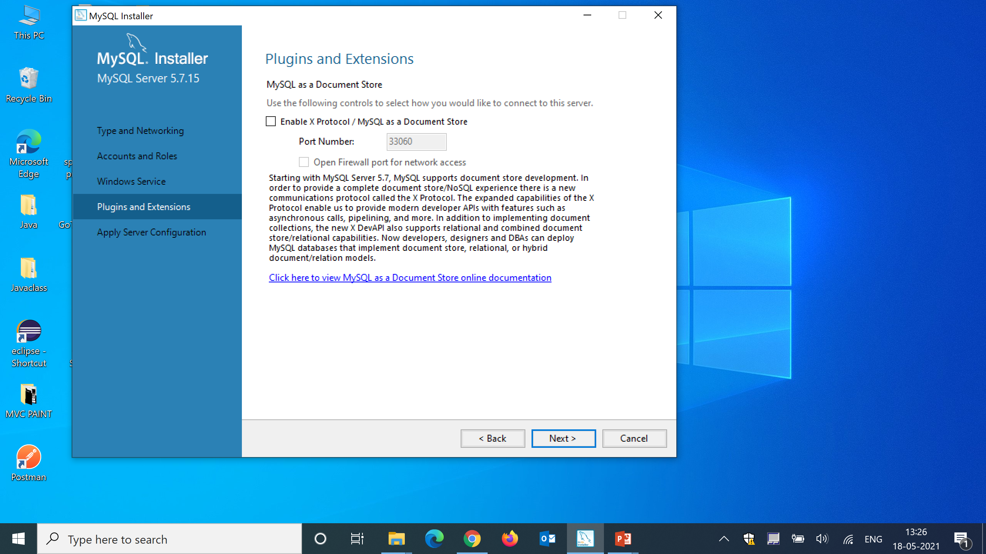
Step 20 :
click on next

Slide 23
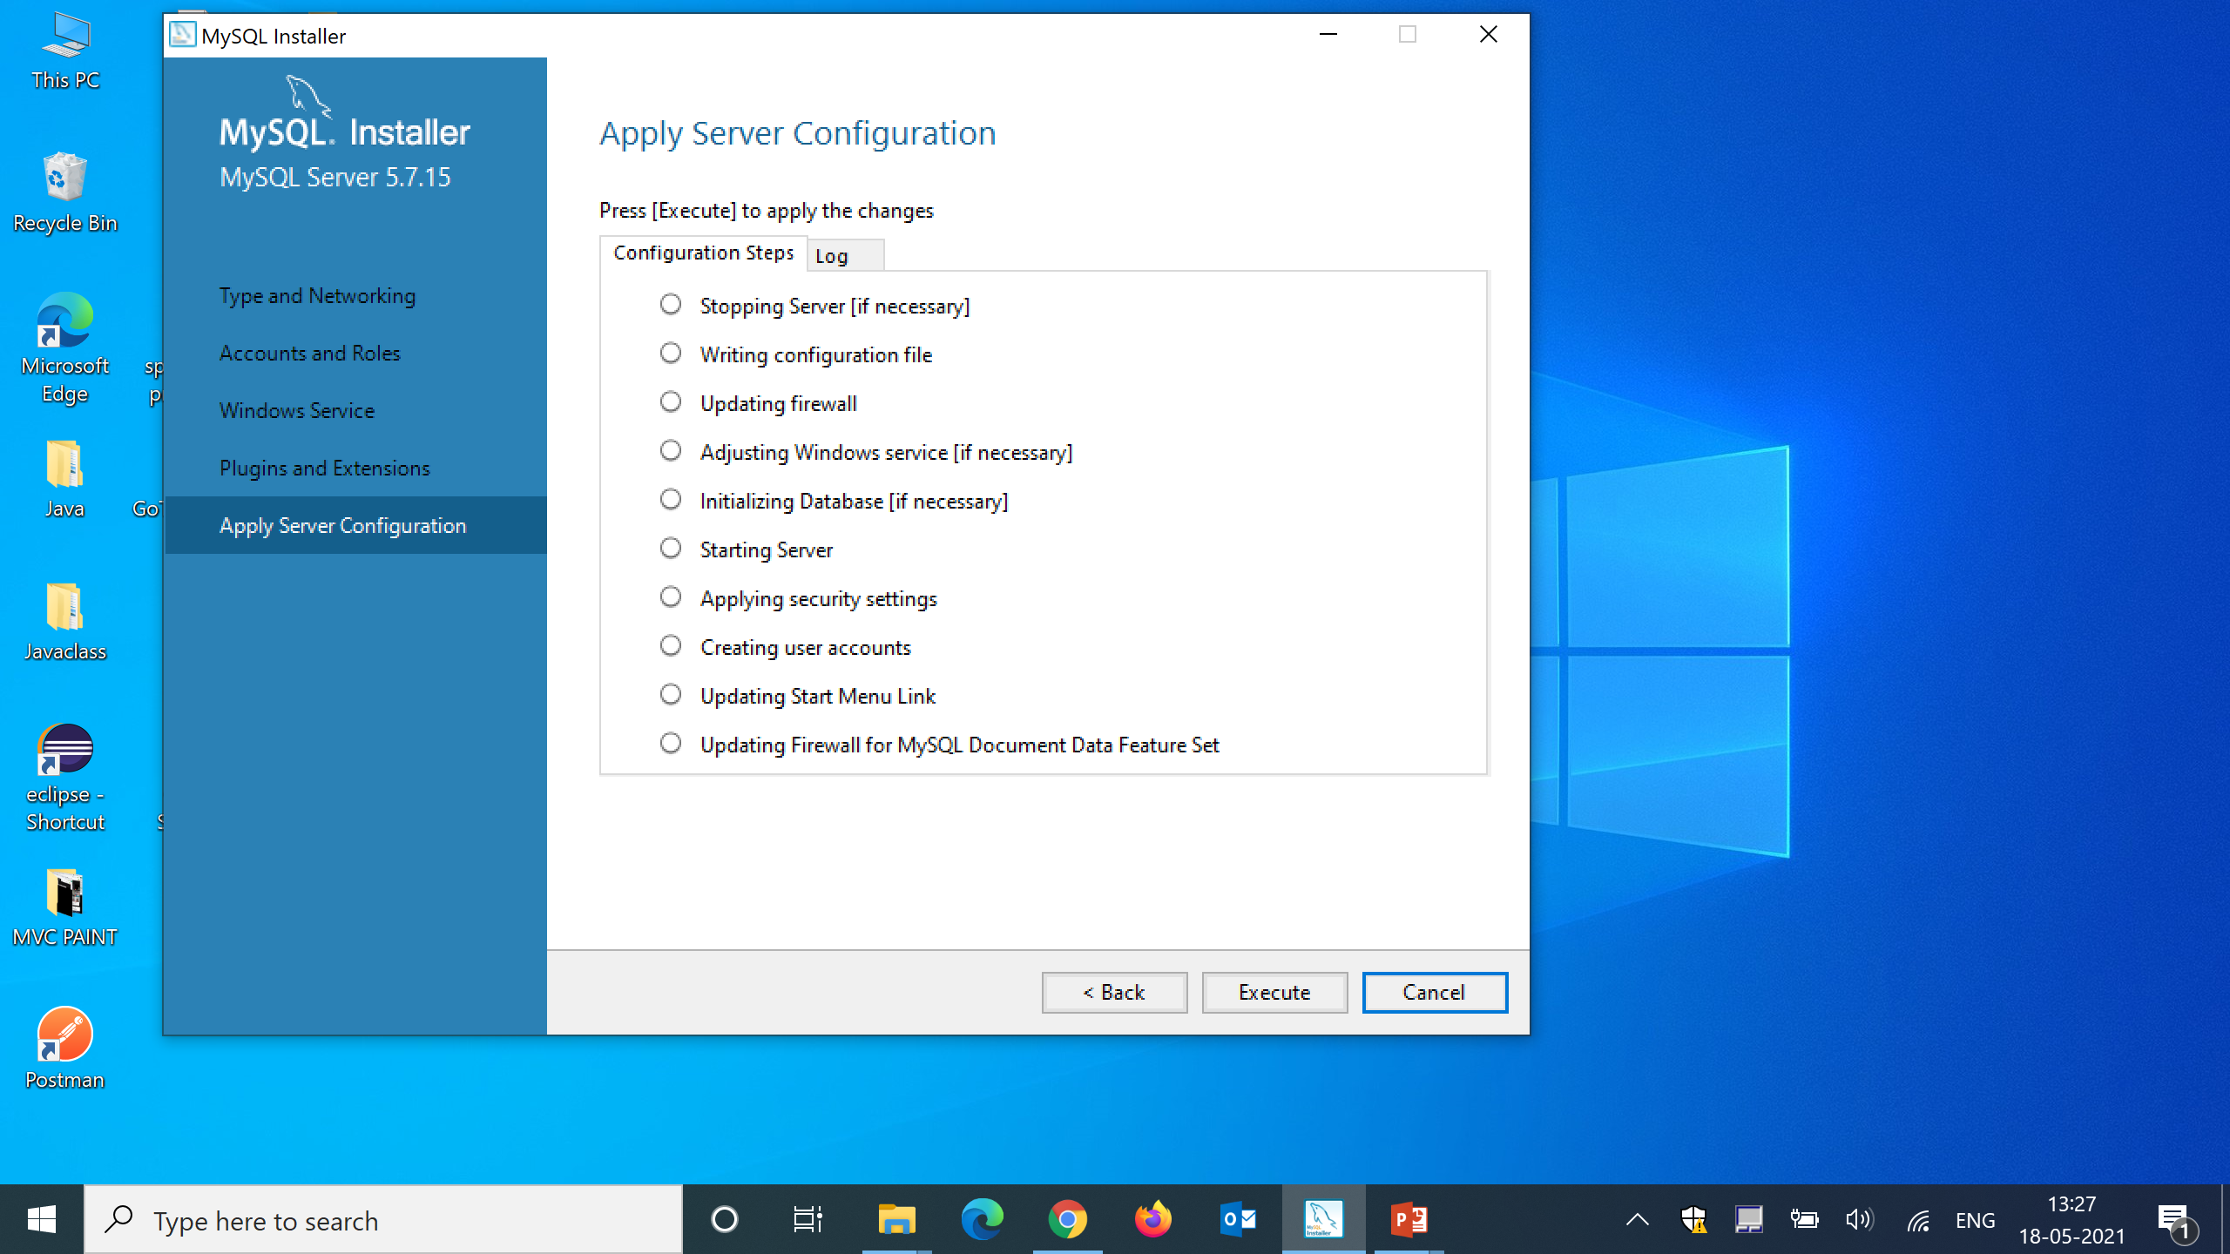
Step 21 :
click on Execute

Slide 24
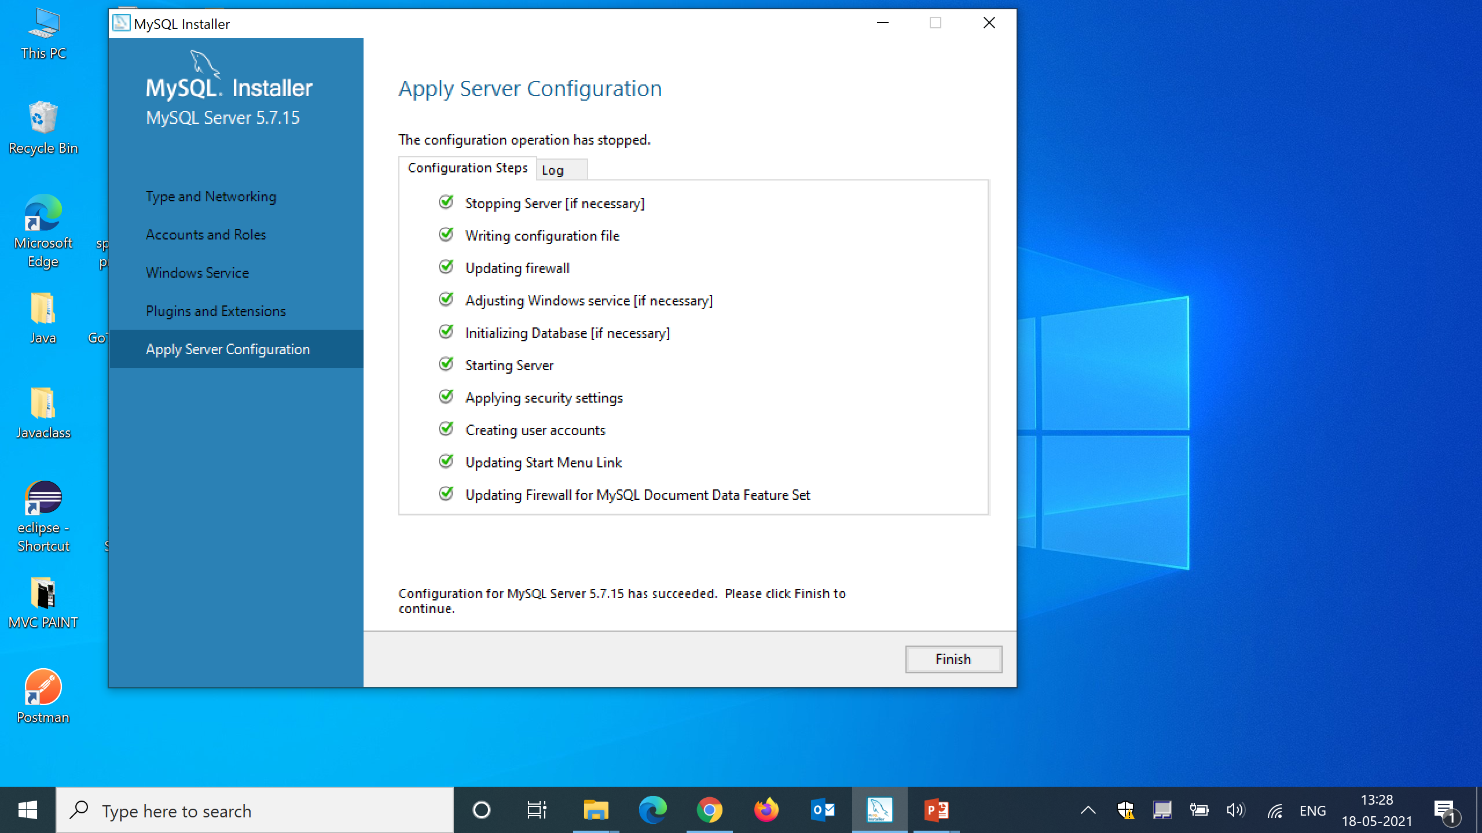
Step 22 :
click on finish

Slide 25
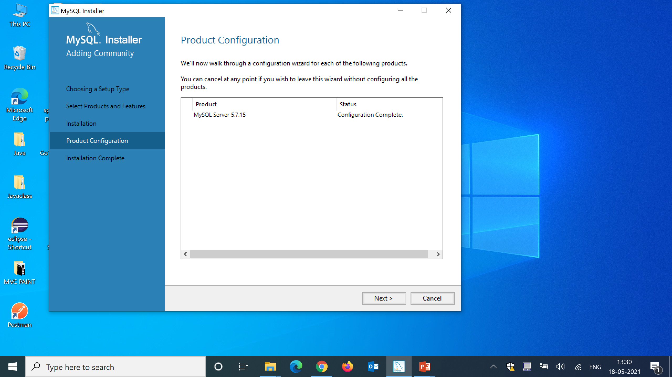
Step 23 :
click on next

Slide 26

Step 24 :
click on finish

